Slide 1
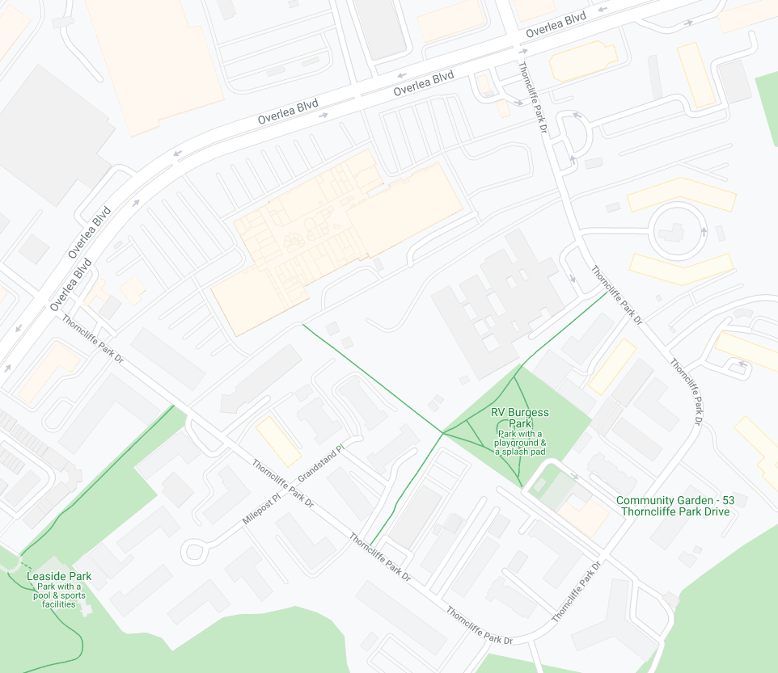
Community Ambassador
Working Session
Parking Lot / Mall Entrance
Parking Lot / Mall Entrance
Parking Lot / Mall Entrance
Parking Lot / Mall Entrance
COVID in the neighbourhood
  Background
  Testing
Role of Ambassadors
Health & Safety
COVID Scenarios?
Resources
  Neighbourhood Resources
  City of Toronto Resources
  Key Contacts for Ambassadors
  COVID Messaging Videos (8 languages)
COVID Test Site
(TNO Youth Centre)
(rear / south parking lot)
45 Overlea Blvd
Parking Lot / Mall Entrance

Slide 2



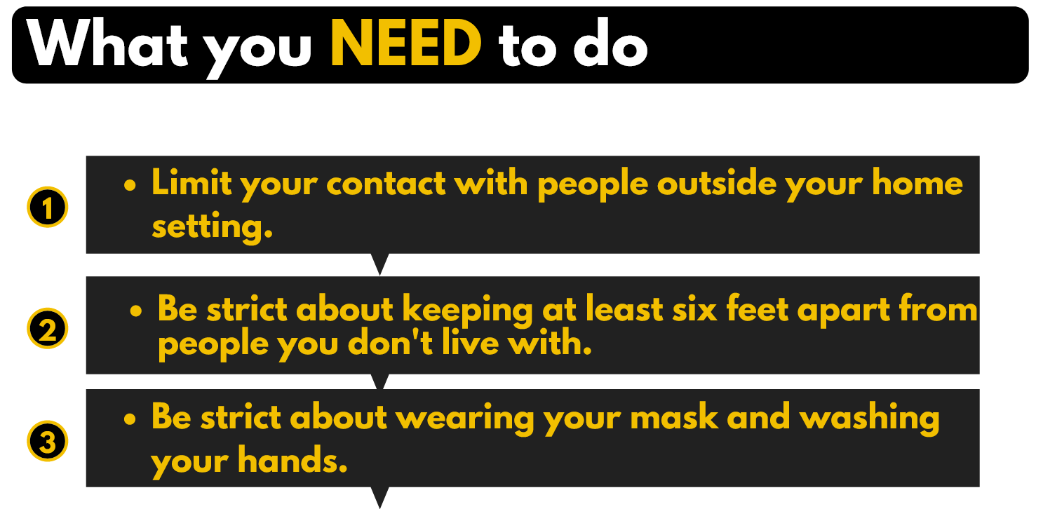
COVID in Thorncliffe Park

Slide 3
COVID in Thorncliffe Park
Testing is available!
If you:
have symptoms of COVID-19, or
think you may be infected (even without symptoms)
We strongly encourage you to get tested at the Thorncliffe Park COVID-19 testing site at 45 Overlea Blvd.
To make an appointment or ask questions,
call the HATP Community Hotline:
647-477-1640
(9am-5pm daily)
Parking Lot / Mall Entrance
Parking Lot / Mall Entrance
Parking Lot / Mall Entrance
Parking Lot / Mall Entrance
COVID Test Site
(TNO Youth Centre)
(rear / south parking lot)
45 Overlea Blvd
Parking Lot / Mall Entrance

Slide 4
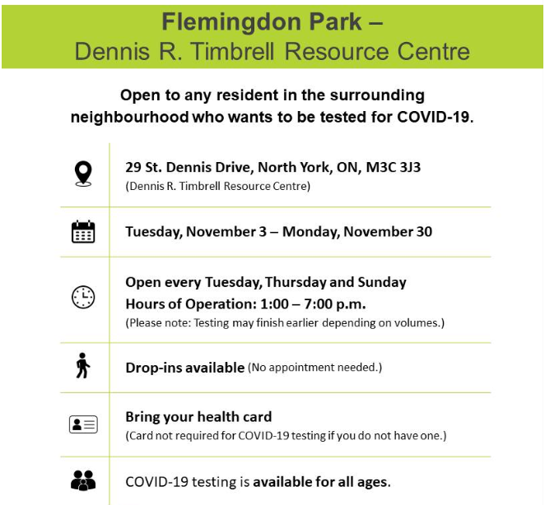
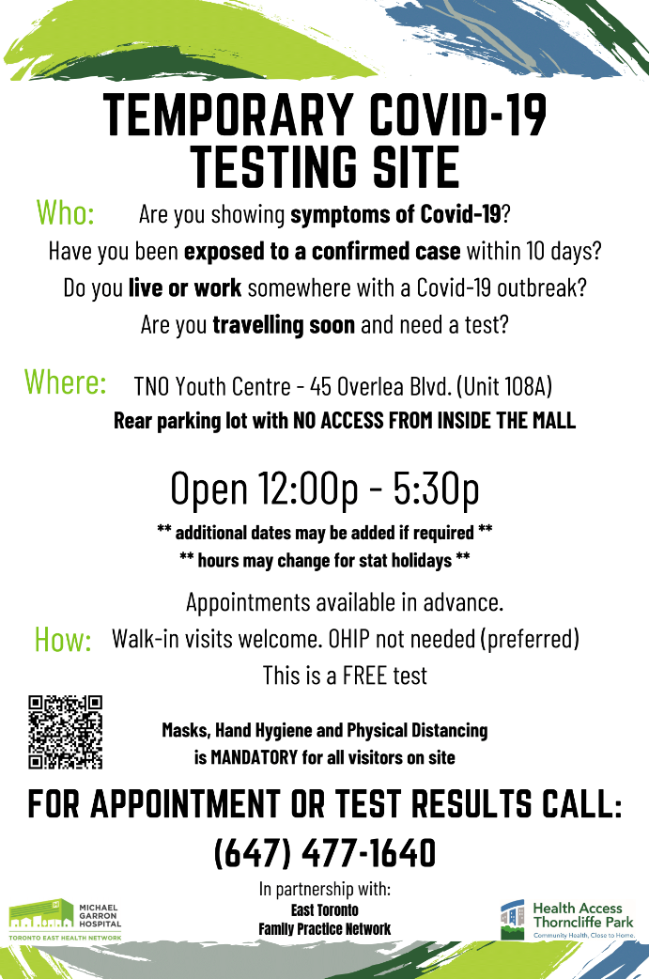
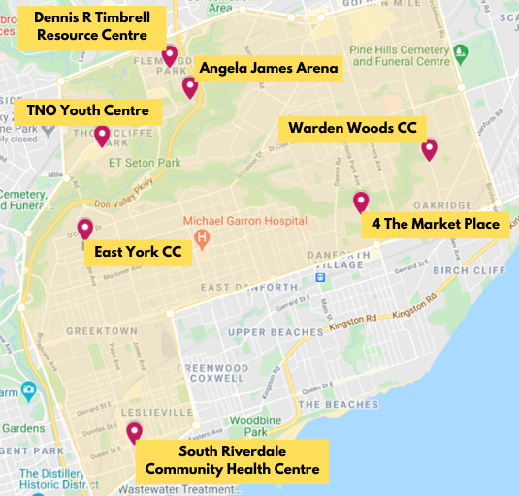
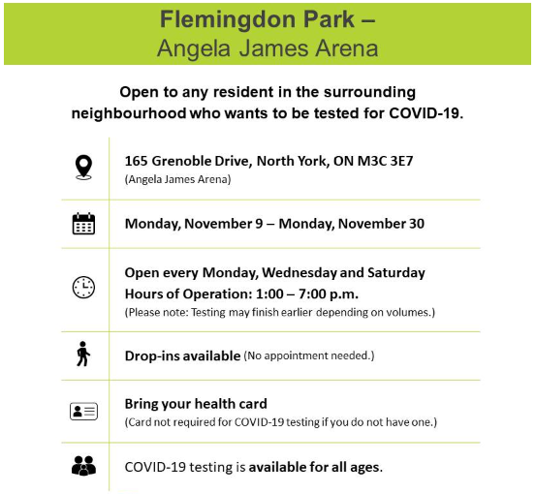
Other COVID
Testing Locations

Slide 5





Role of Community Ambassadors
Provide up-to-date general information about COVID best practices and/or refer residents to appropriate staff
Provide information about COVID relief efforts and resources available to residents from HATP, TNO, FHC, etc. This may also include...
  Navigating residents and referring community inquiries to appropriate community resources and services
  Directing clients to relevant HATP/ TNO/ FHC staff, as needed
Have in-person/ virtual interactions or group ‘chat’ sessions with residents via social media and in-building outreach
  WhatsApp group chats, Facebook messages, text messages
  Other social platforms within your social circle
Connect with and maintain relationships with superintendent, building manager(s), tenants, and tenant groups – via phone calls, social media, etc.
Above all, the goal of the ambassadors is to
build trust with TP residents and engage in meaningful dialogue!

Slide 6









Health and Safety
Please ALWAYS wear PPE, at all the times as per IPAC site guidelines and training
Always wear your face mask and shield while interacting with residents
Regularly sanitize your hands and used equipment; chairs, pens, etc.
If you want to take your PPE off during breaks, please stay outside and away from buildings and residents to avoid any risks of exposure.
Remember that when you interact with residents, you are modeling behaviour!
Always maintain physical distancing. Keep your distance from residents!
Stay hydrated! Bring a water bottle.
Please dress appropriately for the weather! Wear layers to keep warm.

Slide 7

Scenarios to keep in mind
Food & income security
School-going children & student support
Families with elders & senior support
Religious concerns
Front-line workers at home

Slide 8

Neighbourhood Resources
Resource | Organization | Contact Info | Website
COVID Testing | HATP – Community Hotline | 647 477 1640
Food Security | TNO | 416 467 0126 | https://tno-toronto.org/blog/food-banks-other-food-resources
Food Security | Flemingdon Food Bank @ 10 Gateway Blvd | 416 422 4322 | https://www.fcfoodbank.com
Food Security | Afghan Women’s Organization Food Bank @ 200- 747 Don Mills Road | Maryam: 416 422 2225 x 227 Amiri: 416 388 8323 | https://afghanwomen.org/event/food-bank/
Food Security | East York Meals on Wheels @ 2 Thorncliffe Park Drive #52 | 416 424 3322 | https://www.eastyorkmealsonwheels.org
Food Security | Thorncliffe Residents Group | Masood Alam: 647 292 5364
Income Support | TNO | 416 467 0126
Mental Health Support | HATP Social Work | 416 421 6369
Mental Health Support | Toronto Distress Centre | 416 408 HELP (4357) | https://www.dcogt.com/408-help-line
Mental Health Support | Mental Health TO | 1 866 585 MHTO | https://stridestoronto.ca/programs/mental-health-to/
Legal / Housing Support | Don Valley Community Legal Services (DVCLS) | 416-441-1764 x 36 | https://www.donvalleylegal.ca/
Housing Support | TNO (Rent Bank, OESP, LEAP support) | 416 467 0126 | https://tno-toronto.org/housing-programs
Violence against women | TNO | 416 467 0126 | https://tno-toronto.org/programs-women

Slide 9
City of Toronto Resources
  Call the Toronto Public Health Hotline if you have questions about COVID-19
    Open 8:30 am – 8 pm.
    Telephone: 416-338-7600, 416-338-8421
    TTY: 416-392-0658
    Email: PublicHealth@toronto.ca
  Call 311 Toronto for information on city services
    Outside City limits: 416-392-2489,
    Call if you have questions about City services.
      TTY: 416-338-0889
  Call 211 for information on community resources
    You can also text 21166, chat online @ www.211Ontario.ca/chat, or email gethelp@211Ontario.ca

Slide 10

Key Contacts
Name | Role / Resource | Phone | Email
Ayesha Firdouz | CA Main Contact - HATP | 437 245 7063 | afirdouz@healthaccesstp.org
Hafiz Khan | CA Main Contact - TNO |  | hkhan@tno-toronto.org
Esel Panlaqui | CA Main Contact - TNO | 416 996 0818 | epanlaqui@tno-toronto.org
Munira Khilji | CA Main Contact - HATP | 437 333 9964 | mkhilji@healthaccesstp.org
Masood Alam | 43 TPD Community Lead | 647 292 5364 | malam@ymail.com
Abdul Rauf Jangda | 49 TPD Community Lead | 647 909 0275 | Raufjay@gmail.com
Shakeel Ahmed | 71 TPD Communit y Lead | 647 831 7327
Dr. Shakhlo Sharipova | 43 TPD & Autism Network | 647 606 5732 | sh2010sharipova@gmail.com
Syed | 43 TPD Community Lead |  | syedmoid.benazir@icloud.com
Charles Zhu | Leader from Parenting Group | 416 509 6477 | cxjzhu@yahoo.ca
Najia Zewari | 43 TPD & Cycling Network | 647 785 8514

Slide 11

COVID Messaging: Videos
Arabic
  https://youtu.be/2JG5Z7zVNvI
  https://youtu.be/hyIGDmYuwB4
Bengali
  https://youtu.be/-nz941Yu2yU
Cantonese
  https://youtu.be/IQ2FnaGW8Uk
Farsi
  https://youtu.be/xJsAE-kTHek
Hindi
  https://youtu.be/hftBWluuV6A
Mandarin
  https://youtu.be/echnQYWFMmI
Tamil
  https://youtu.be/39SPluqvzPc
Urdu
  https://youtu.be/8IVN47hHYwA
  https://youtu.be/2NnEAJPaPLk
  https://youtu.be/TPWQ62KhdiQ
Full playlist here:
https://www.youtube.com/playlist?list=PLpGOiwBWGwgv3Lwdui-c4v9UKQ_OkN1R0

Slide 12

Notes & comment tracking
Use this page to note recurring concerns or individuals to follow-up with
Note | Contact Info (if needed)

Slide 13
Notes & comment tracking
Use this page to note recurring concerns or individuals to follow-up with
Note | Contact Info (if needed)

